Slide 1
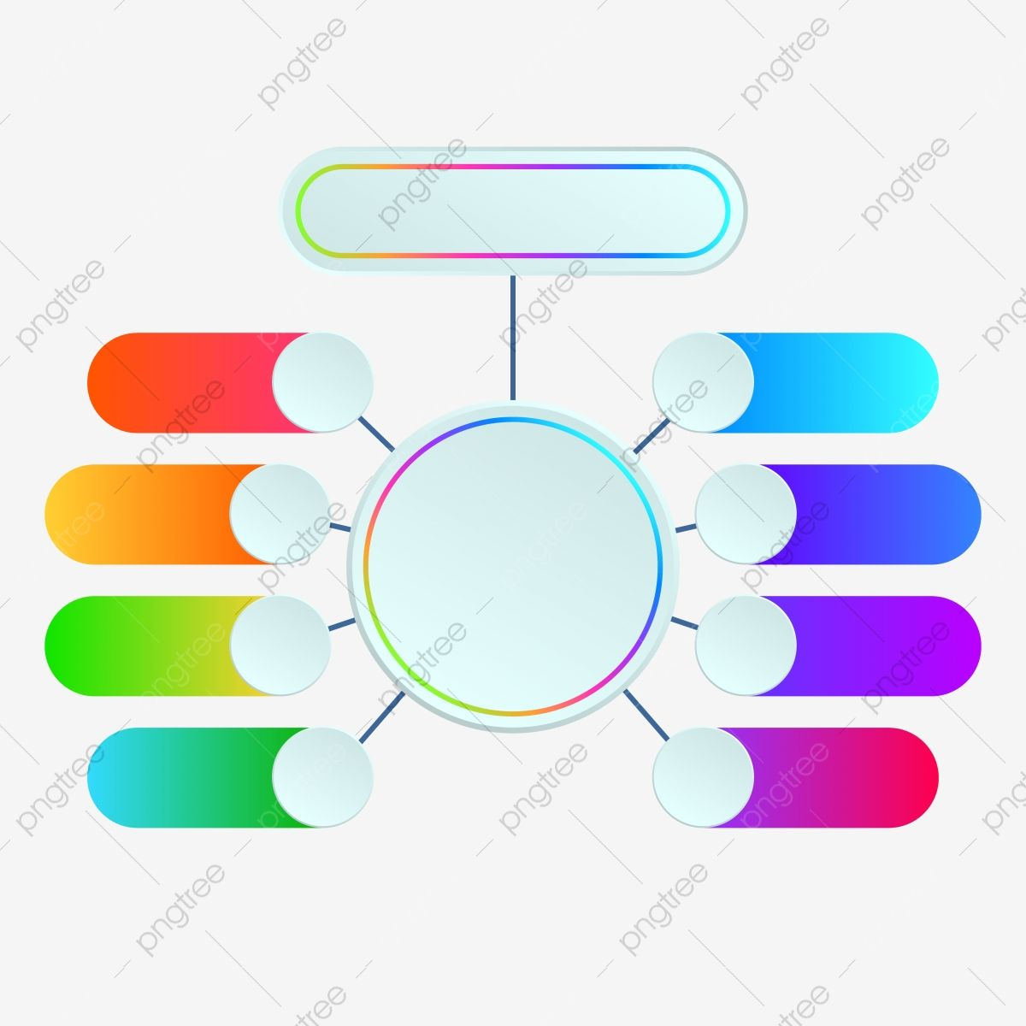
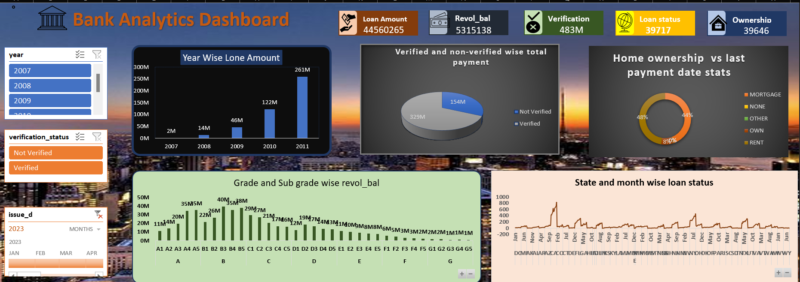
EXCEL
EXCEL
EXCEL
Data Manipulation :
Power query editor,
Pivot table
1
5
3rd KPI : Verified & Non-Verified wise Total payment {Sum}
1
With the help of shapes we have created KPI’s
2
6
4th KPI : State & Month wise Loan Status {Count}
1st KPI : Year wise Loan amount {Sum}
5th KPI : Home Ownership vs Last Payment date Stats {Count}
3
7
2nd KPI : Grade & Subgrade wise Revol_bal {Sum}
4
8
Used Slicers : Year, Verification Status, Issue_d

Slide 2

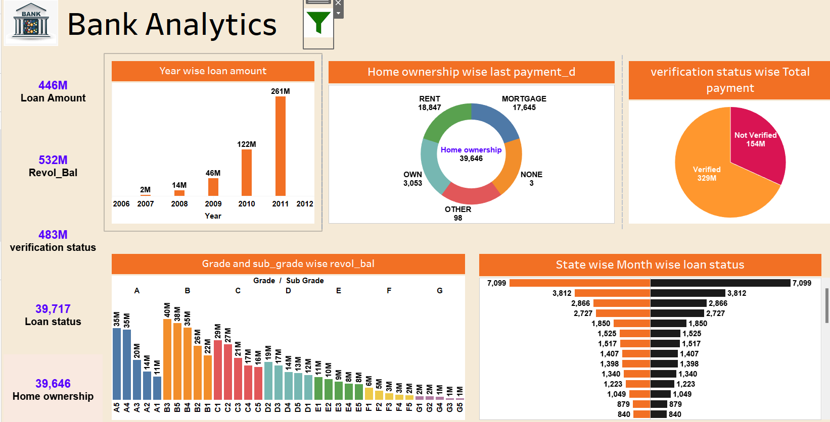
TABLEAU
Data Manipualtion : Clean data, import data into tableau and we used full outer join in order to get output from both the tables.
1
KPI’s : We have created all KPI with the help of dimension and measures and also used aggregate function.
2
Dashboard : We have used Horizontal and Vertical Container for making dashboard.
3
Slicers : we have exploited Year, Grade, Verification, Addr State , Month and Home ownership as Slicer in dashboard.
4
Advanced Filter : we applied Hide and Show Filter , Applied Logo and used Action filter in order to make interactive Dashboard.
5

Slide 3
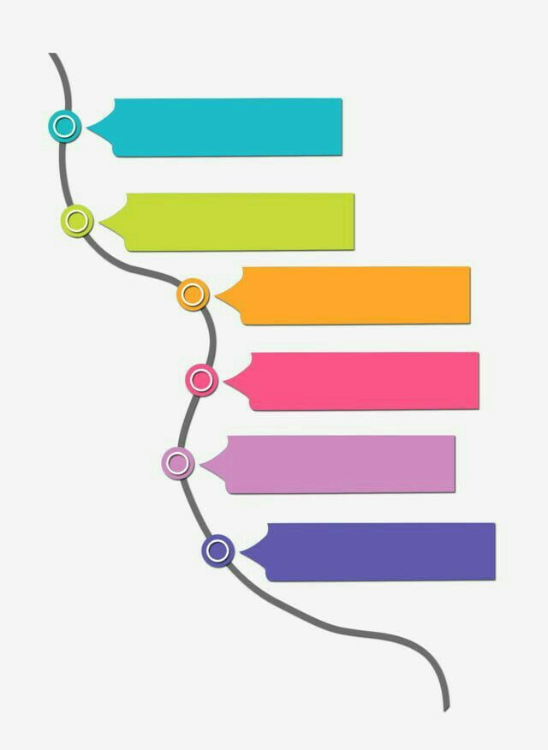
MYSQL
1
Data Manipulation: we have converted actutal date formate of Issue_d into Custom Format after that imported data in MySQL & created database.
2
1st KPI : We applied aggregate function {Sum} and used Group By And Order By as Year.
3
2nd KPI : In Order to get 2nd KPI we have operated Full outer join , used group by as grade & subgrade and order by as subgrade.
4
3rd KPI : We applied Inner Join as well as aggregate function{Count} and Round function also group by Verification status.
5
4th KPI : We have used aggregate function{Count} ,Group By Addr State and Month, Order By Addr State.
6
5th KPI : We applied Full Outer Join and Group By as Home Ownership

Slide 4

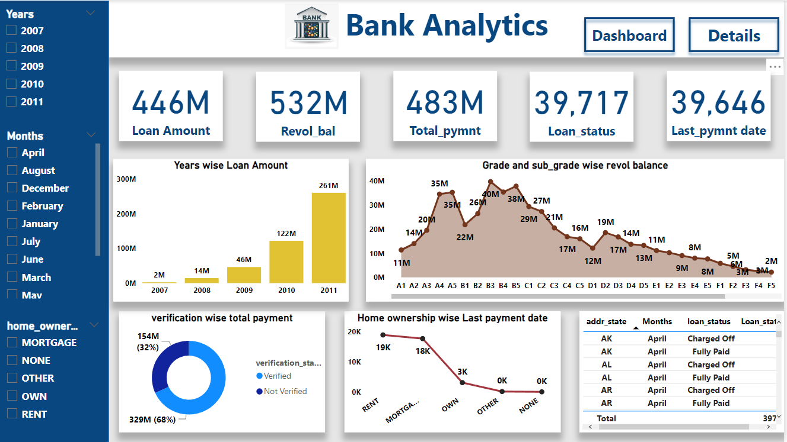
POWER BI
Data Manipulation : Cleaned Data in power query editor and Load data, in model we established relation between two table .
KPI’s : With the help of card we have made all KPI ,Simply drag and drop the values in kpi.
1
1
4
2
2
Button : We have created dashboard and details as button for the action of this button used bookmark.
Filter : Year, Month, Home ownership and also applied logo.
3

Slide 5


CONCLUSION
CONCLUSION
We can conclude overall result as revol_bal is increased in 2007 as compared to 2011.
After 2007 the growth is continuously increasing.
The integration of analytics into the loan process can lead to a win-win situation for both banks and customers. It enables banks to make more informed decisions, reduce risks, and enhance profitability, while customers benefit from a smoother, more personalized, and secure lending experience. To succeed in this endeavor, banks should prioritize data quality, privacy, and ongoing innovation in their analytics strategies.
We can conclude overall result as revol_bal is increased in 2007 as compared to 2011.
After 2007 the growth is continuously increasing.
The integration of analytics into the loan process can lead to a win-win situation for both banks and customers. It enables banks to make more informed decisions, reduce risks, and enhance profitability, while customers benefit from a smoother, more personalized, and secure lending experience. To succeed in this endeavor, banks should prioritize data quality, privacy, and ongoing innovation in their analytics strategies.

